Slide 1
DataScientest Project Translator

Slide 2
Concept
Translation app
Container-orchestrated
Complete from frontend development, backend development, infrastructure provisioning, helm deployment
Automated deployed in every environment
EKS cluster

Slide 3
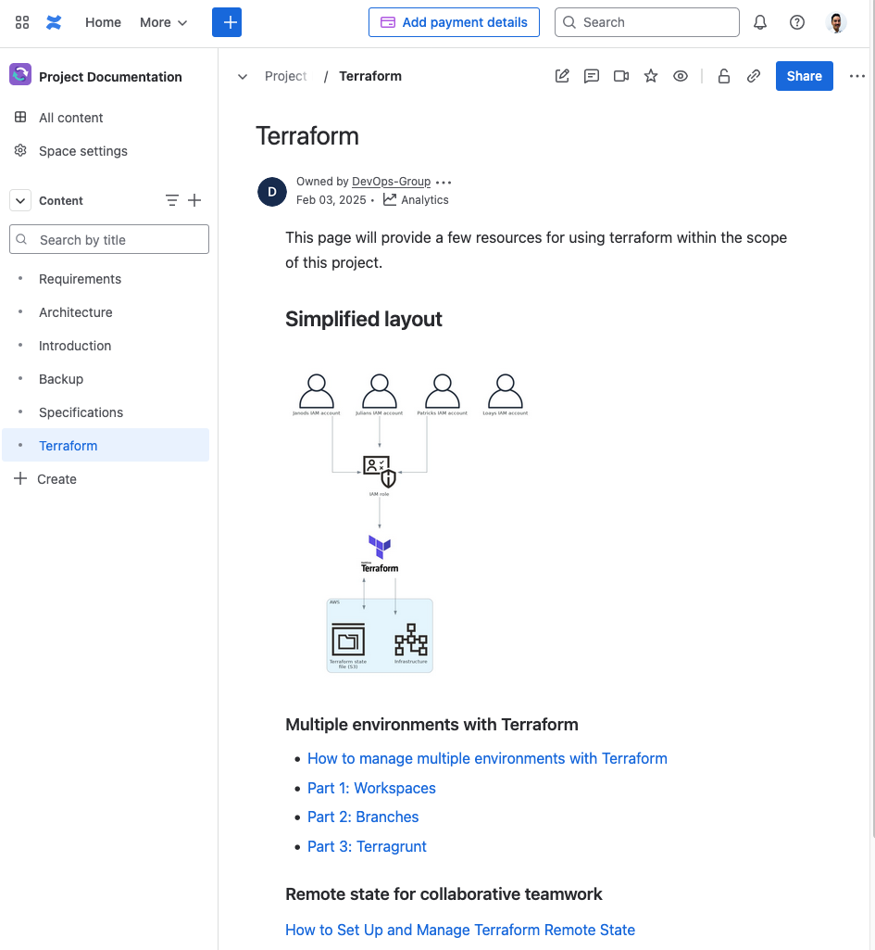
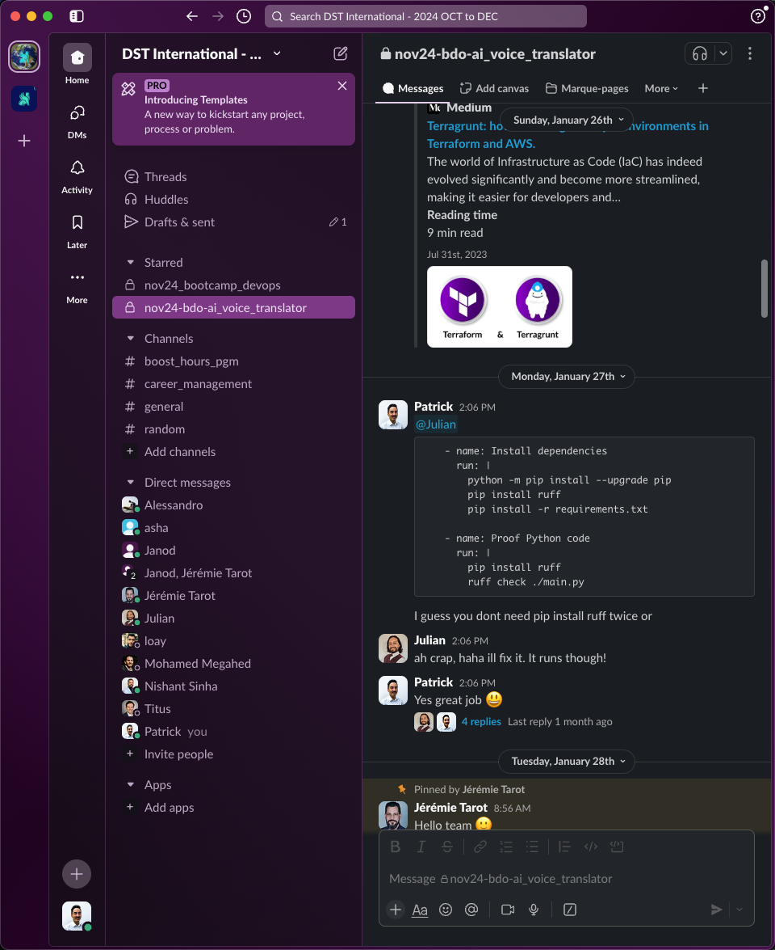
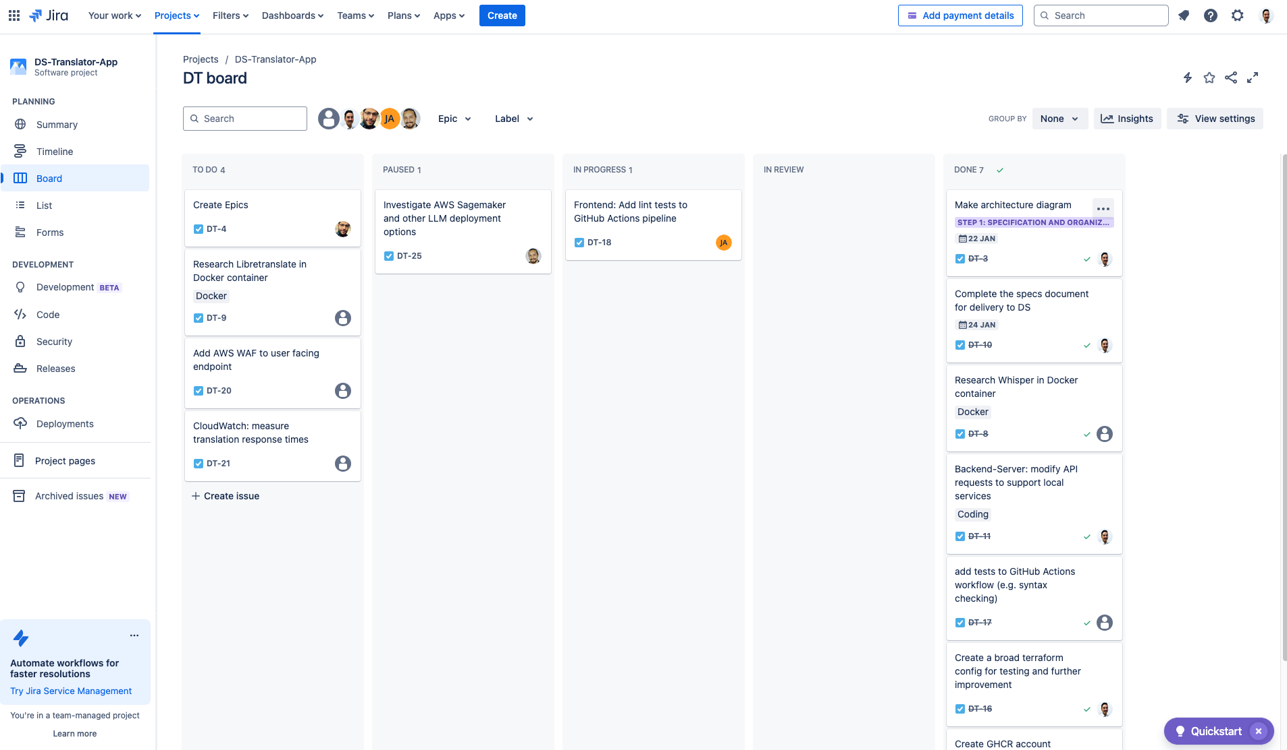
Collaboration

Slide 4
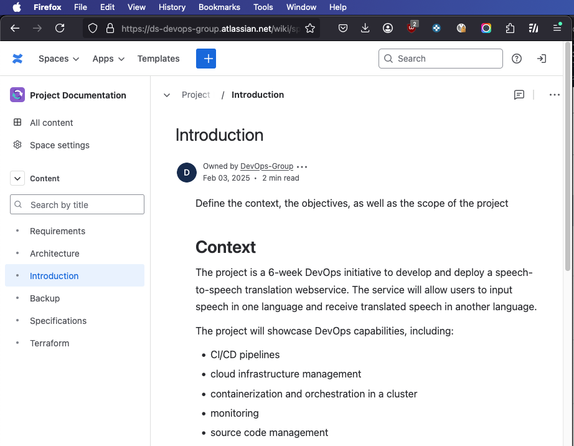
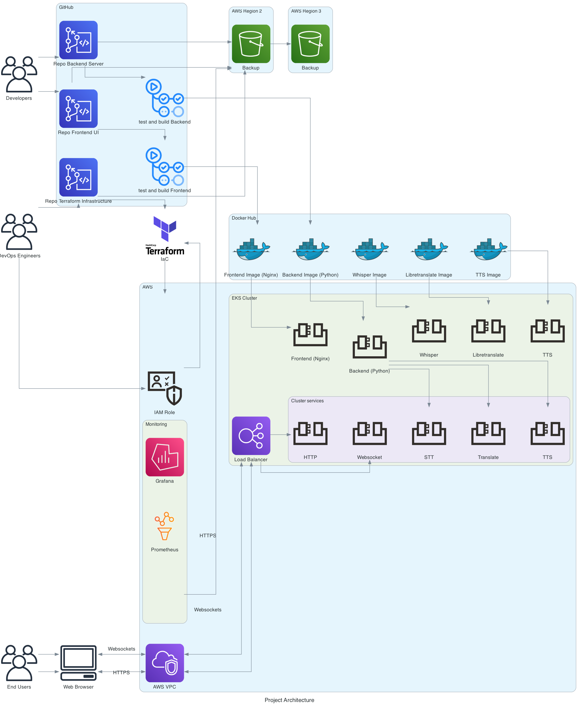
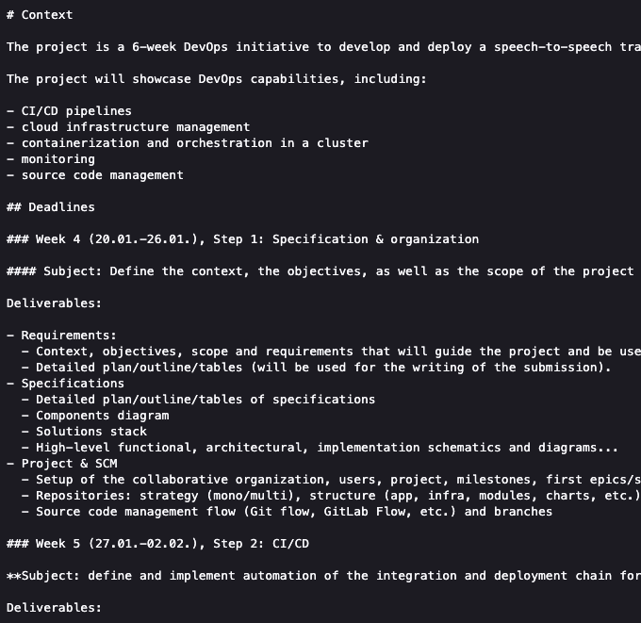
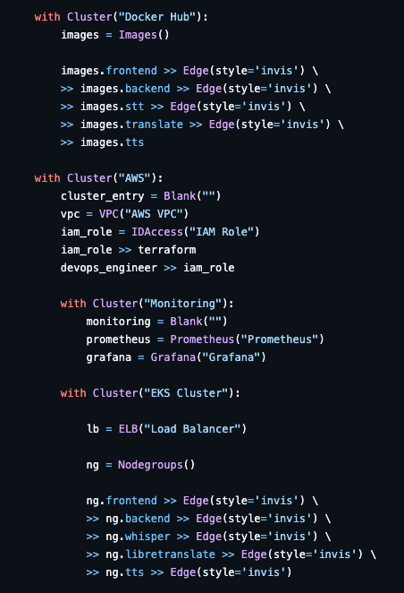
Write once, deploy everywhere
Markdown Deploy to Confluence, GitHub Pages, HTML, PDF etc.
Diagrams as Code Easy to change

Slide 5





Repository Organization
Documentation
Frontend
Backend
Infrastructure
Deployment
Confluence
Container
Container
Cloud
Orchestrator

Slide 6






Application Pipeline
GitHub Actions
Syntax check (Ruff)
Build image
Trivy image scan
Upload to GHCR
Upload to
S3 bucket

Slide 7
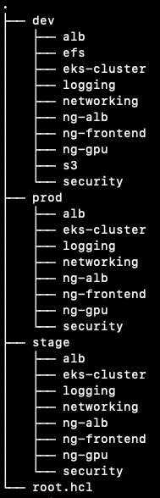
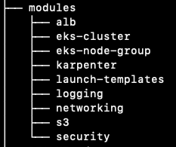

Keep It Dry
Development
Staging
Production

Slide 8











Infrastructure Pipeline
Local computer
Source Control
GitHub Actions
Terraform Plan (terragrunt run-all)
Terraform Apply
(terragrunt run-all)
Check for pods not running
AWS Cloud
Terraform State
Terraform Lock
Another computer

Slide 9













Architectural Overview
AWS Region “us-east-1”
AWS Region “eu-west-3”
Virtual private cloud (VPC)
Domain (DNS)
Availability Zone 1 of 2
User / Browser
Public subnet
Private subnet
Recovery
Internet
gateway
EKS Cluster
Application Load Balancer
Infrastructure
Configuration
GitHub
Actions
Node Groups
Storage
NAT gateway
IAM
Storage
DynamoDB
CloudWatch
S3 Bucket
Local
Computer
Bootstrap
Configuration

Slide 10





Deployment Pipeline
dev
GitHub Actions
Checks
(helm lint)
Set up storage driver, pv and pvc
Install chart and deployment
DNS record update
Tests
Packaging artifact
stage
prod
Set up storage driver, pv and pvc
Install chart and deployment
DNS record update
Tests
Tests
DNS record update
Install chart and deployment
Set up storage driver, pv and pvc

Slide 11











Cluster
AWS Cloud
EKS Cluster
CloudWatch
General Node Group
GPU Node Group
Application Load Balancer
Ingress
Metrics Insights
Storage
Frontend
Backend
STT
Inference
TTS
ALB Controller
Logs
S3 Bucket
Alarm
EBS Volume
CSI Driver
Mount
Observability Add-on

Slide 12
Obstacles

